Slide 1

Hi Guys

Slide 2

Hi Guys
SUPER STORE SALES ANALYSIS
INTRODUCTION
BY SARATHKUMAR N S - DA&DS – APR25

Slide 3
INTRODUCTION
WE ARE GOING SEE HOW TO CLEAN THE DATA AND USING THE CLEANED DATA,
WE ARE GOING TO ANALYZE THE KPI’S AND INSIGHTS USING PIVOT TABLES & PIVOT CHARTS TO FIND THE HIGH AND LOW PERFORMING CRITERIA, TO EASE THE UNDERSTANDING OF THE ANALYSIS WE ARE GOING TO CREATE AN INTERACTIVE DASHBOARD WHICH WILL HAVE THE VISUALIZATION OF THE ALL KPI’SAND INSIGHTS

Slide 4



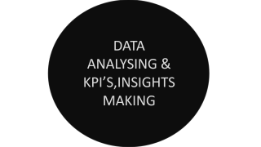



INTRODUCTION
WE ARE GOING SEE HOW TO CLEAN THE DATA AND USING THE CLEANED DATA,
WE ARE GOING TO ANALYZE THE KPI’S AND INSIGHTS USING PIVOT TABLES & PIVOT CHARTS TO FIND THE HIGH AND LOW PERFORMING CRITERIA, TO EASE THE UNDERSTANDING OF THE ANALYSIS WE ARE GOING TO CREATE AN INTERACTIVE DASHBOARD WHICH WILL HAVE THE VISUALIZATION OF THE ALL KPI’SAND INSIGHTS
WE ARE GOING SEE HOW TO CLEAN THE DATA AND USING THE CLEANED DATA,
WE ARE GOING TO ANALYZE THE KPI’S AND INSIGHTS USING PIVOT TABLES & PIVOT CHARTS TO HIGH AND LOW PERFORMINGAREAS , TO EASE THE UNDERSTANDING OF THE ANALYSIS WE ARE GOING TO CREATE A INTERACTIVE DASHBOARD WHICH WILL HAVE THE VISUALIZATION OF THE ALL KPI’SAND IMSIGHTS

Slide 5

WE ARE GOING SEE HOW TO CLEAN THE DATA AND USING THE CLEANED DATA,
WE ARE GOING TO ANALYZE THE KPI’S AND INSIGHTS USING PIVOT TABLES & PIVOT CHARTS TO FIND THE HIGH AND LOW PERFORMING AREAS , TO EASE THE UNDERSTANDING OF THE ANALYSIS WE ARE GOING TO CREATE A INTERACTIVE DASHBOARD WHICH WILL HAVE THE VISUALIZATION OF THE ALL KPI’SAND IMSIGHTS
ANALYSIS FLOW
WE ARE GOING SEE HOW TO CLEAN THE DATA AND USING THE CLEANED DATA,
WE ARE GOING TO ANALYZE THE KPI’S AND INSIGHTS USING PIVOT TABLES & PIVOT CHARTS TO HIGH AND LOW PERFORMINGAREAS , TO EASE THE UNDERSTANDING OF THE ANALYSIS WE ARE GOING TO CREATE A INTERACTIVE DASHBOARD WHICH WILL HAVE THE VISUALIZATION OF THE ALL KPI’SAND IMSIGHTS
THANK YOU

Slide 6
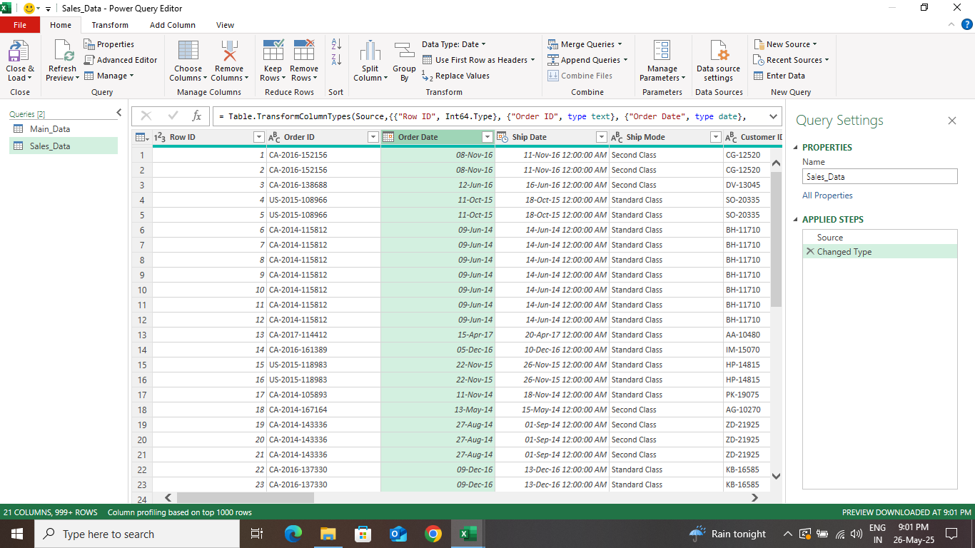
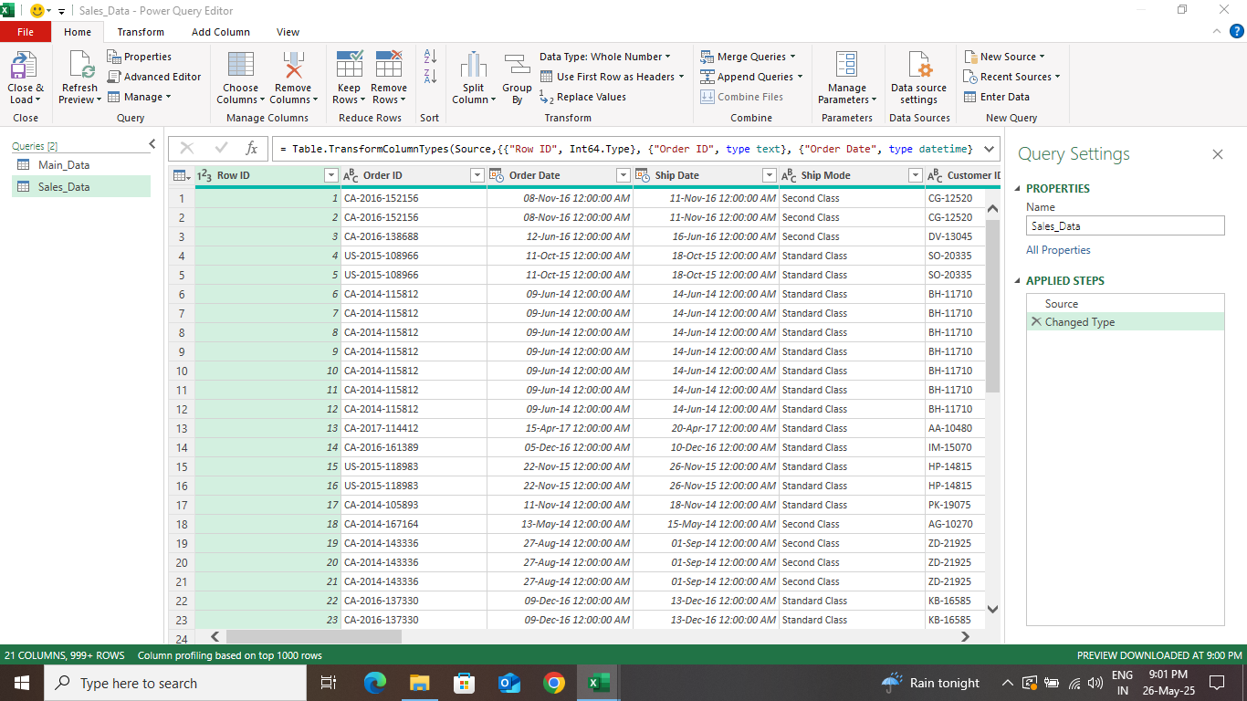
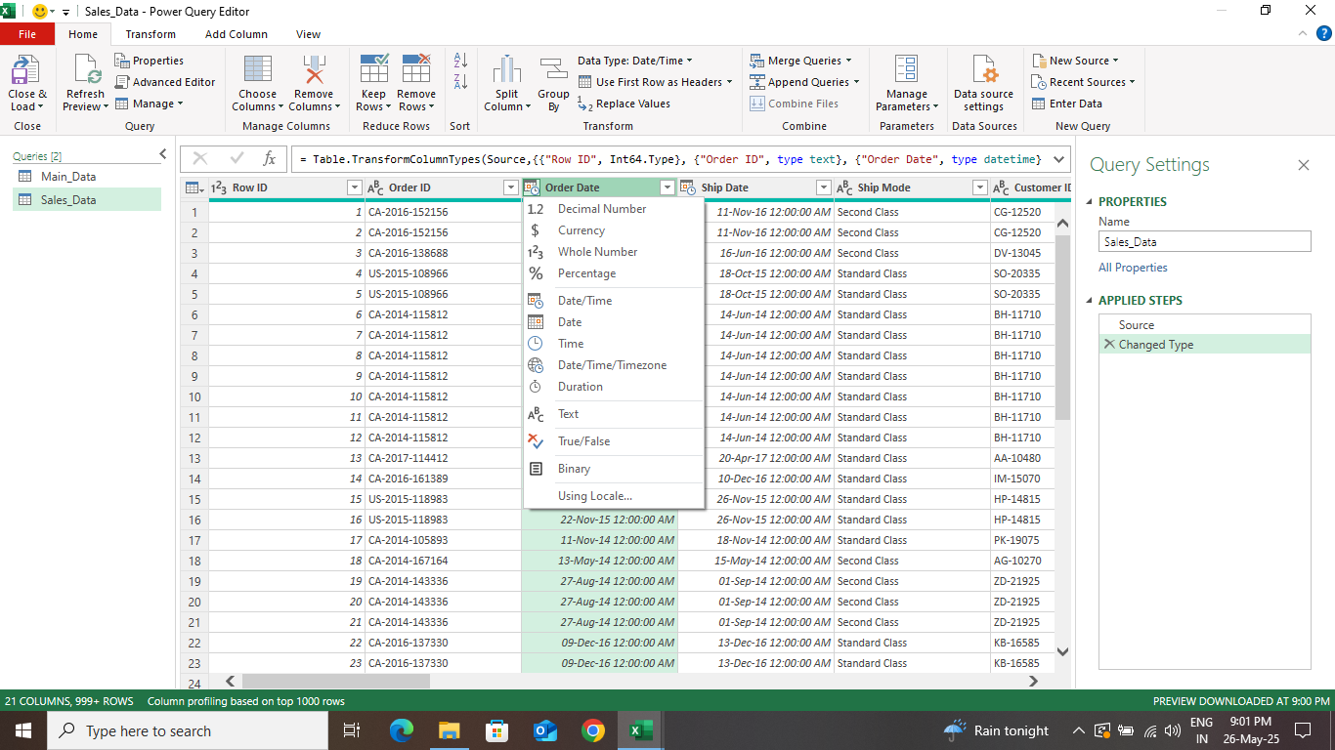
DATA CLEANING & WALK THROUGH
CLEANING DATA USING POWER QUERY EDITOR:
USING THE POWER QUERY YOU CAN CHANGE THE FORMATS OF THE EACH COLUMN.
USING THE YOU CAN REMOVE DUPLICATE DATAS,ROWS USING THE “REMOVE DUPLICATES” OPTION.
AND ALSO YOU CAN ADD CUSTOM COLUMN AND REMOVE BLANK ROWS AND COLUMN.
AND YOU CAN ALSO CHANGE THE TABLE NAME AS WELL.
DATA CLEANING & WALK THROUGH

Slide 7
DATA CLEANING & WALK THROUGH
CHANGING DATE FORMAT USING POWER QUERY
CLEANING DATA USING POWER QUERY EDITOR:
FIRST YOU NEED TO ANALYZE THE DATA AND ADD COLUMNS MANUALLY.
AND ALSO, YOU CAN ADD, CUSTOMIZE AND INTER-CHANGE COLUMN AND ALSO REMOVE BLANK ROWS BY SELECTING “REMOVE DUPLICATES” BY RIGHT CLICKING THE HEADER OF COLUMN IN POWER QUERY.
USING THE POWER QUERY, YOU CAN CHANGE THE FORMATS OF THE EACH COLUMN USING THE “FORMAT ICON”.
USING THE P.Q.E, YOU CAN REMOVE DUPLICATE DATAS,ROWS USING THE “REMOVE DUPLICATES” OPTION.
AND YOU CAN ALSO CHANGE THE TABLE NAME AS WELL.

Slide 8
DATA CLEANING & WALK THROUGH
CHANGING DATE FORMAT USING POWER QUERY
CLEANING DATA USING POWER QUERY EDITOR:
FIRST YOU NEED TO ANALYZE THE DATA AND ADD COLUMNS MANUALLY.
AND ALSO, YOU CAN ADD, CUSTOMIZE AND INTER-CHANGE COLUMN AND ALSO REMOVE BLANK ROWS BY SELECTING “REMOVE DUPLICATES” BY RIGHT CLICKING THE HEADER OF COLUMN IN POWER QUERY.
USING THE POWER QUERY, YOU CAN CHANGE THE FORMATS OF THE EACH COLUMN USING THE “FORMAT ICON”.
USING THE P.Q.E, YOU CAN REMOVE DUPLICATE DATAS,ROWS USING THE “REMOVE DUPLICATES” OPTION.
AND YOU CAN ALSO CHANGE THE TABLE NAME AS WELL.

Slide 9

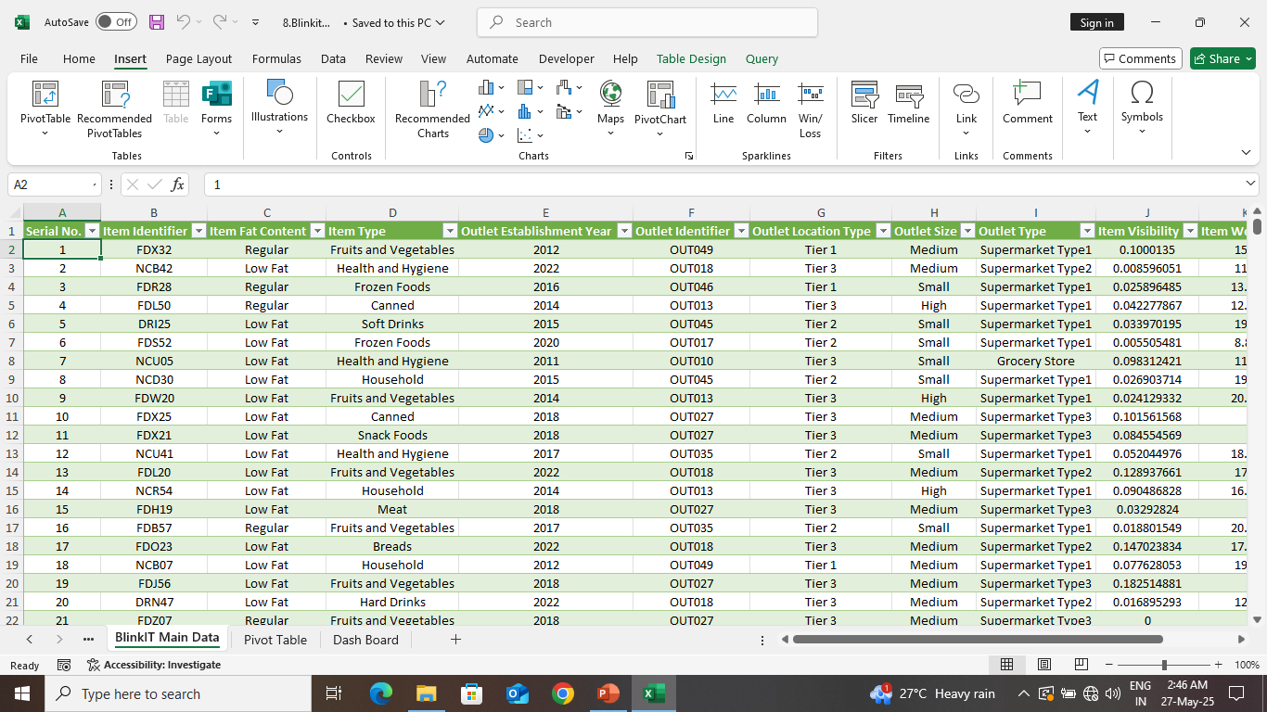
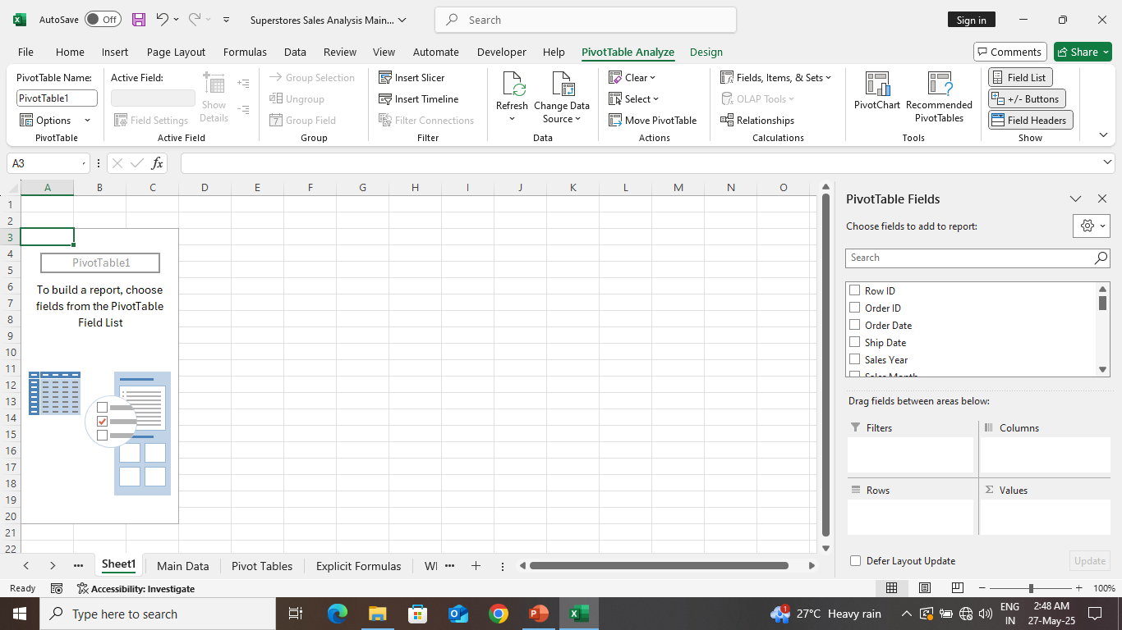
DATA ANALYSING & INSIGHTS MAKING
CREATING KPI’S & INSIGHTS:
SELECT ANY CELL IN YOUR MAIN DATA TABLE, THEN USING “INSERT OPTION” YOU CAN CREATE THE PIVOT TABLE.
YOU CAN DRAG AND DROP THE COLUMN FROM MAIN TABLE INTO THE PIVOT TABLE USING THE “FIELD LIST” OPTION TO INSERT VALUES INSIDE PIVOT TABLE TO ANALYZE THE DATA.
USING “PIVOT TABLE ANALYZE TAB” IN THE TOOLBAR , YOU CAN INSERT PIVOT CHART TO GET THE VISUAL DATA.
AFTER THAT YOU CAN CUSTOMIZE YOUR PIVOT CHART.
DATA ANALYSING & KPI’S,INSIGHTS MAKING

Slide 10
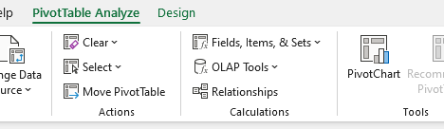
DATA ANALYSING & INSIGHTS MAKING
INSERTING VALUES INTO PIVOT TABLE
CREATING KPI’S & INSIGHTS:
SELECT ANY CELL IN YOUR MAIN DATA TABLE, THEN USING “INSERT OPTION” YOU CAN CREATE THE PIVOT TABLE.
YOU CAN DRAG AND DROP THE COLUMN FROM MAIN TABLE INTO THE PIVOT TABLE USING THE “FIELD LIST” OPTION TO INSERT VALUES INSIDE PIVOT TABLE TO ANALYZE THE DATA.
USING “PIVOT TABLE ANALYZE TAB” IN THE TOOLBAR , YOU CAN INSERT PIVOT CHART TO GET THE VISUAL DATA.
AFTER THAT YOU CAN CUSTOMIZE YOUR PIVOT CHART.

Slide 11
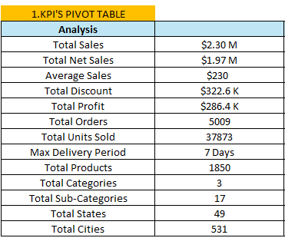
DATA ANALYSING & INSIGHTS MAKING
INSERTING VALUES INTO PIVOT TABLE
KPI’s PIVOT TABLE
CREATING KPI’S & INSIGHTS:
SELECT ANY CELL IN YOUR MAIN DATA TABLE, THEN USING “INSERT OPTION” YOU CAN CREATE THE PIVOT TABLE.
YOU CAN DRAG AND DROP THE COLUMN FROM MAIN TABLE INTO THE PIVOT TABLE USING THE “FIELD LIST” OPTION TO INSERT VALUES INSIDE PIVOT TABLE TO ANALYZE THE DATA.
USING “PIVOT TABLE ANALYZE TAB” IN THE TOOLBAR , YOU CAN INSERT PIVOT CHART TO GET THE VISUAL DATA.
AFTER THAT YOU CAN CUSTOMIZE YOUR PIVOT CHART.

Slide 12
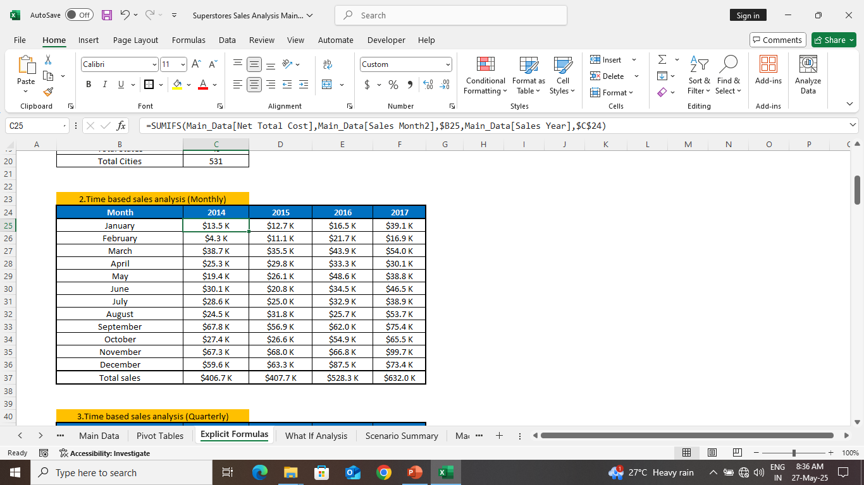
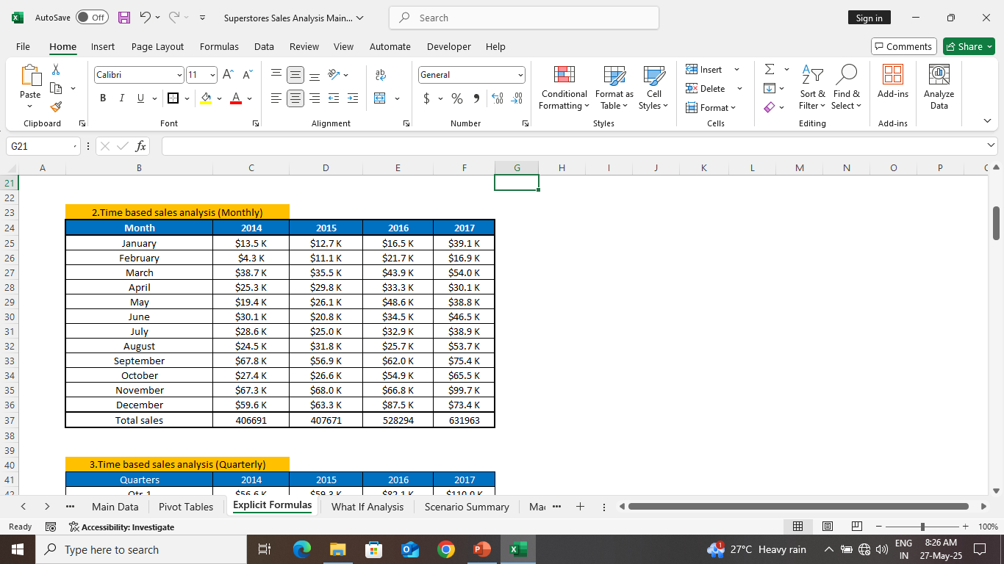
INSERTING VALUES INTO PIVOT TABLE
KPI’s PIVOT TABLE
TIME BASED SALES ANALYSIS

Slide 13
KPI’s PIVOT TABLE
TIME BASED SALES ANALYSIS
TIME BASED SALES ANALYSIS (MONTHLY)

Slide 14
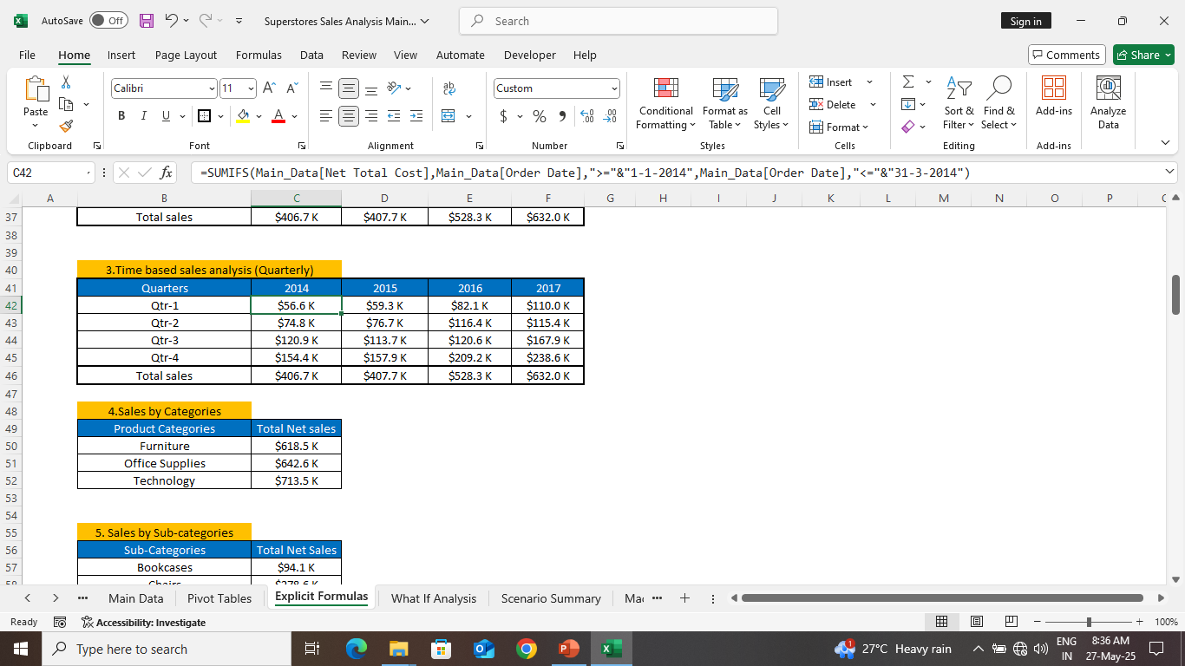
TIME BASED SALES ANALYSIS
TIME BASED SALES ANALYSIS (MONTHLY)
TIME BASED SALES ANALYSIS (QUARTERS)

Slide 15

TIME BASED SALES ANALYSIS (MONTHLY)
TIME BASED SALES ANALYSIS (QUARTERS)
TIME BASED SALES ANALYSIS (QUARTERLY)

Slide 16
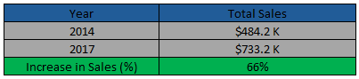
TIME BASED SALES ANALYSIS (QUARTERS)
TIME BASED SALES ANALYSIS (QUARTERLY)
TIME BASED SALES ANALYSIS (YEARLY)

Slide 17
TIME BASED SALES ANALYSIS (QUARTERLY)
TIME BASED SALES ANALYSIS (YEARLY)
TOTAL SALES BY CATEGORY

Slide 18
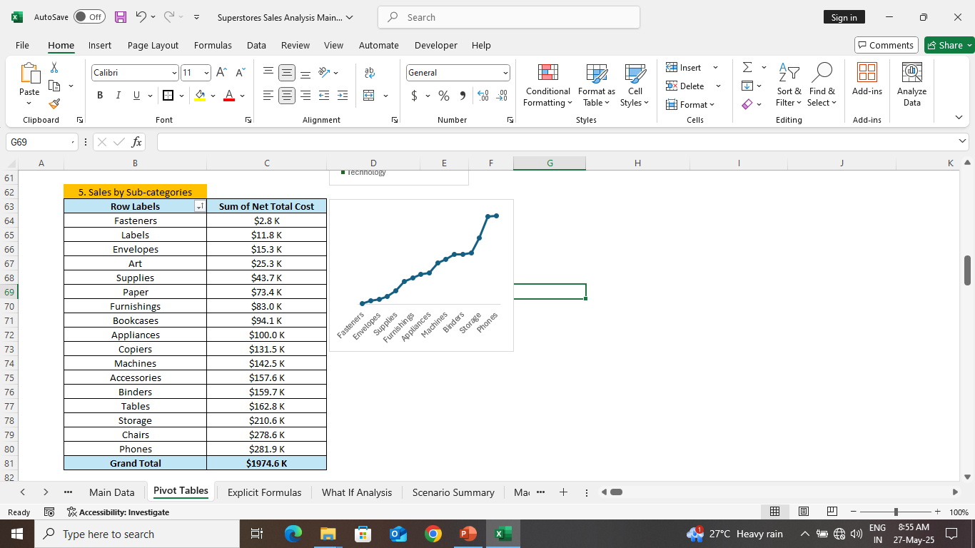
TIME BASED SALES ANALYSIS (YEARLY)
TOTAL SALES BY CATEGORY
TOTAL SALES BY SUB-CATEGORY
SALES BY CITIES

Slide 19
TOTAL SALES BY CATEGORY
TOTAL SALES BY SUB-CATEGORY
TOTAL SALES BY SUB-CATEGORY
SALES BY CITIES

Slide 20
TOTAL SALES BY SHIP MODE
TOTAL SALES BY SHIP MODE
TOTAL SALES BY SUB-CATEGORY
TOTAL SALES BY SUB-CATEGORY

Slide 21
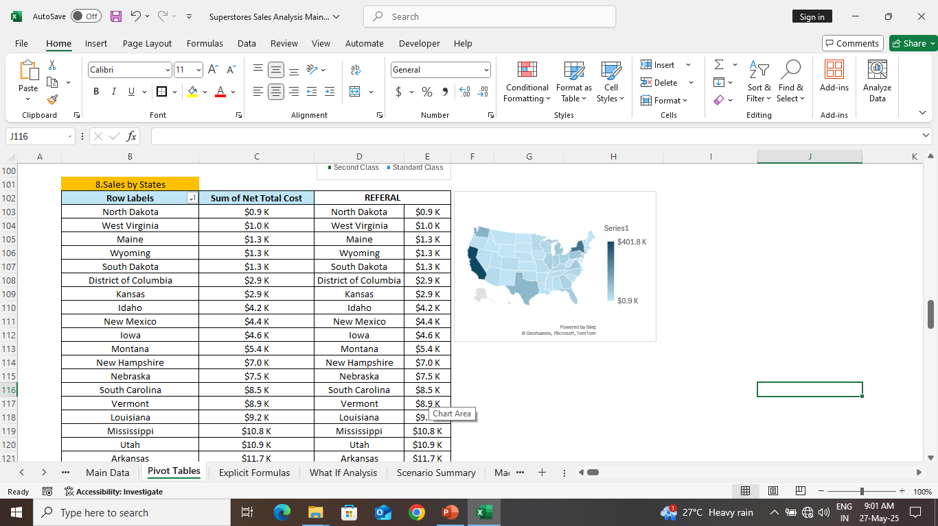
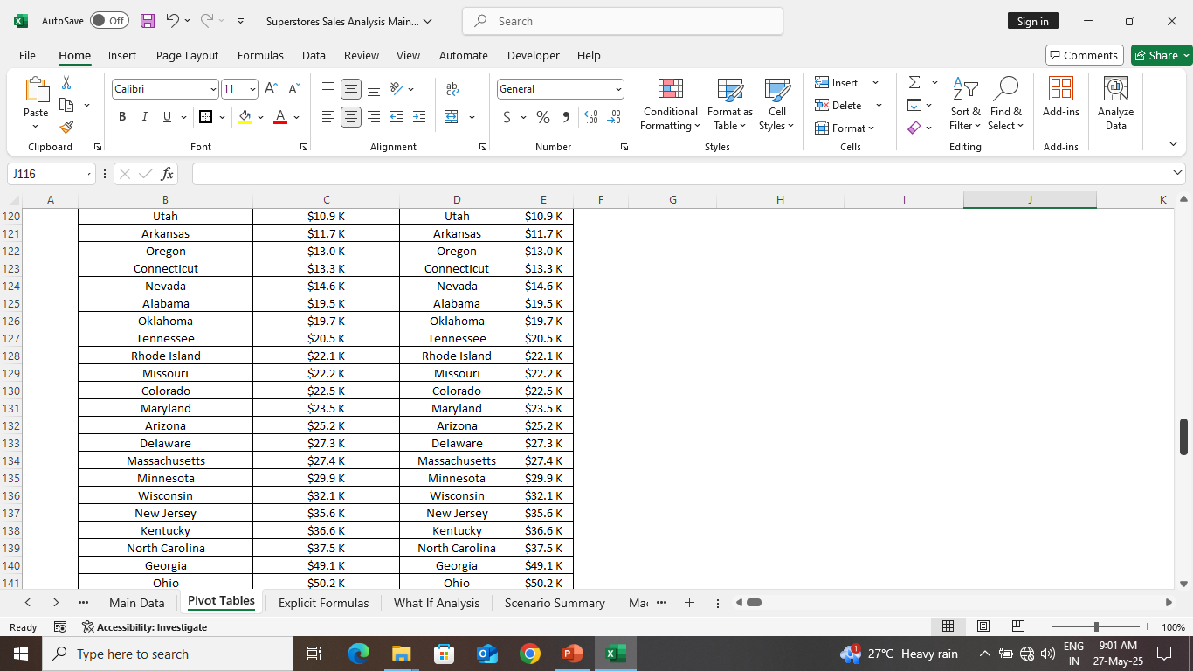
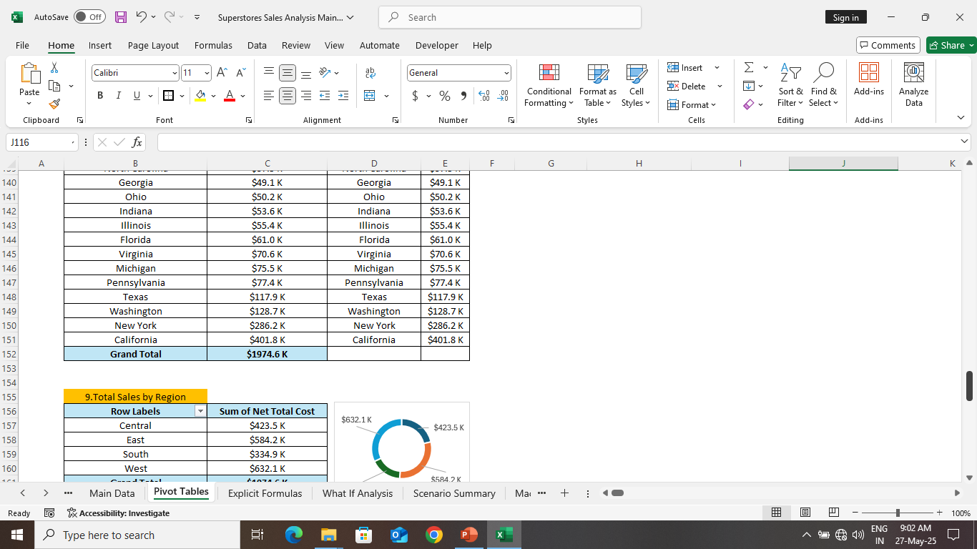
TOTAL SALES BY SHIP MODE
TOTAL SALES BY SUB-CATEGORY
SALES BY CITIES

Slide 22
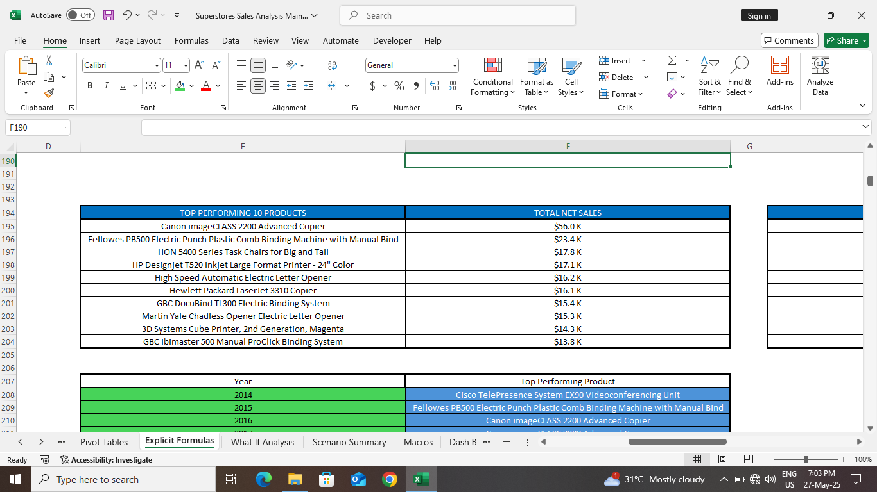
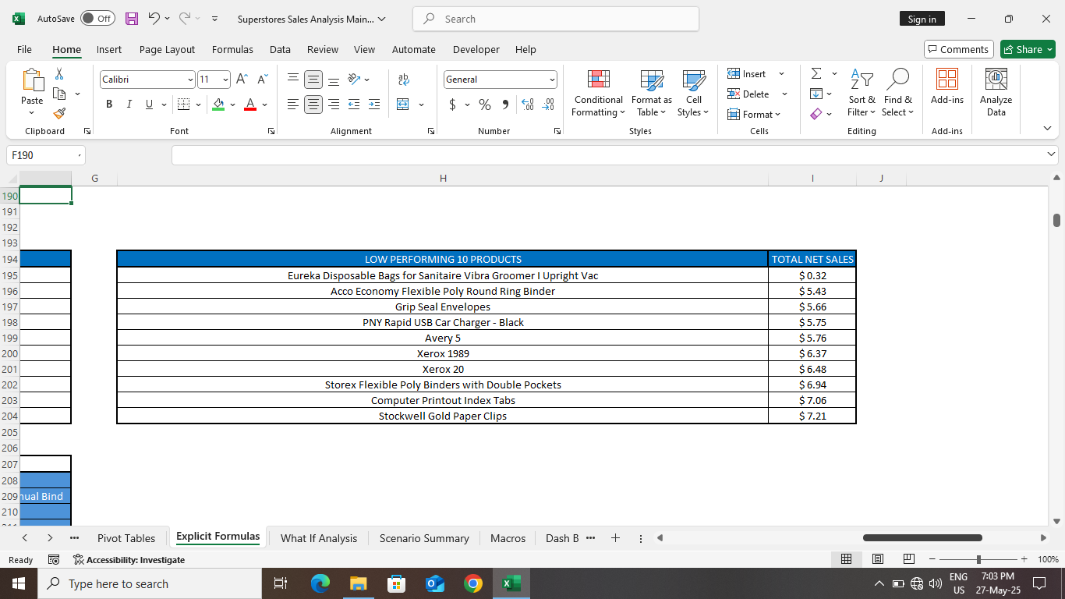
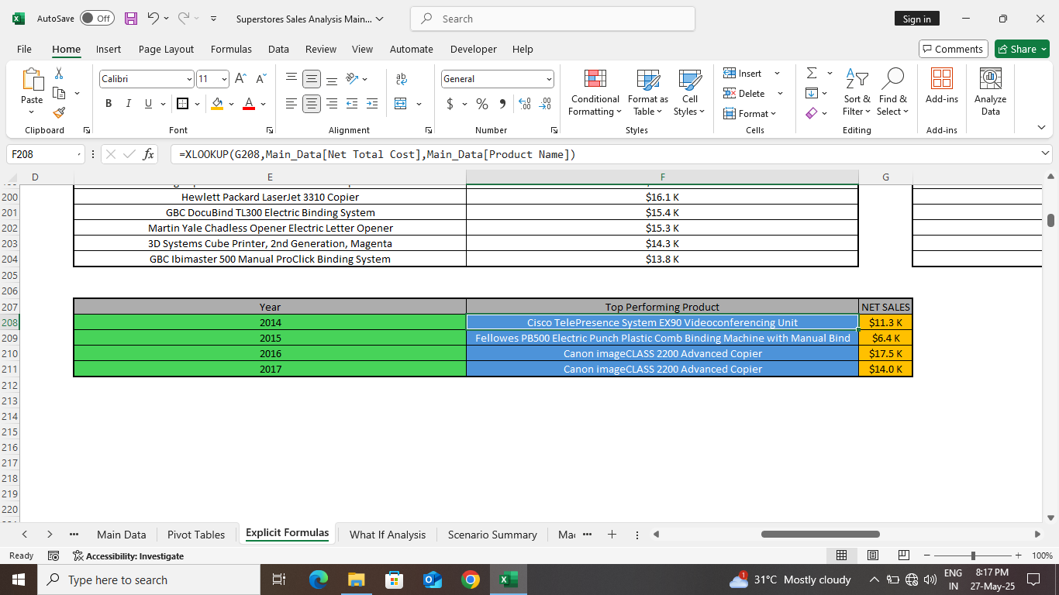
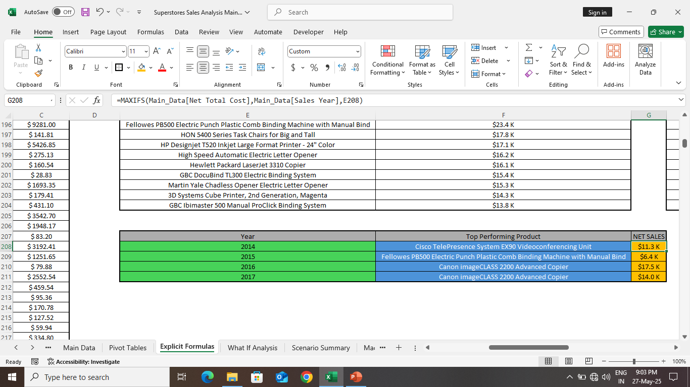
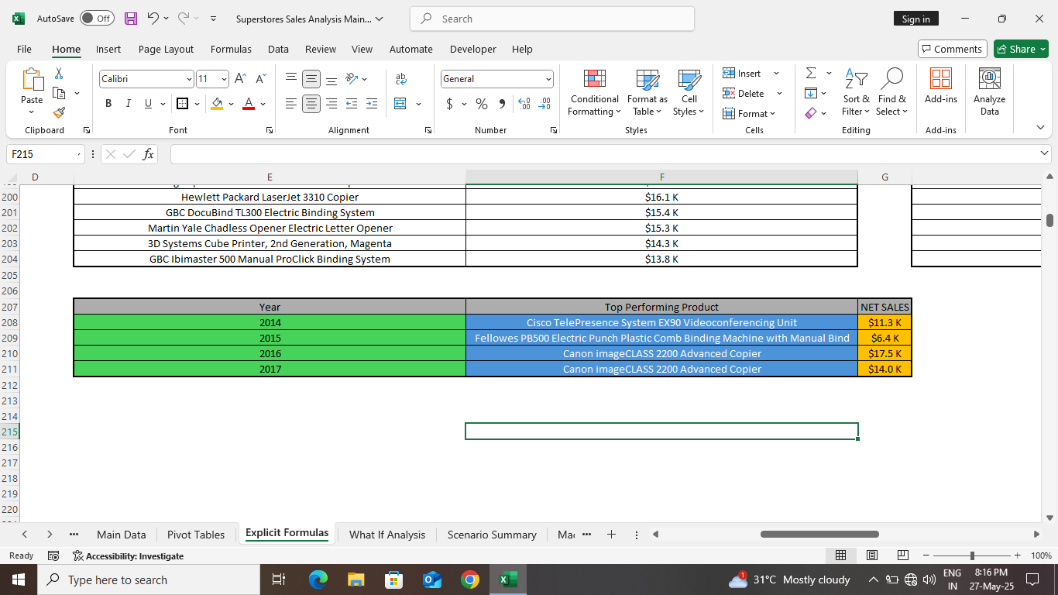
TOTAL SALES BY SHIP MODE
SALES BY CITIES
TOP PERFORMING PRODUCTS

Slide 23
SALES BY CITIES
TOP PERFORMING PRODUCTS
TOP PERFORMING PRODUCTS

Slide 24
TOP PERFORMING PRODUCTS
TOP PERFORMING PRODUCTS
LOW PERFORMING PRODUCTS

Slide 25
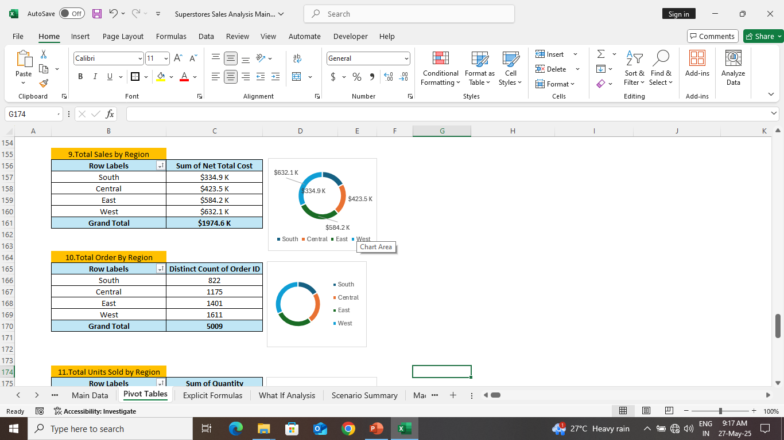
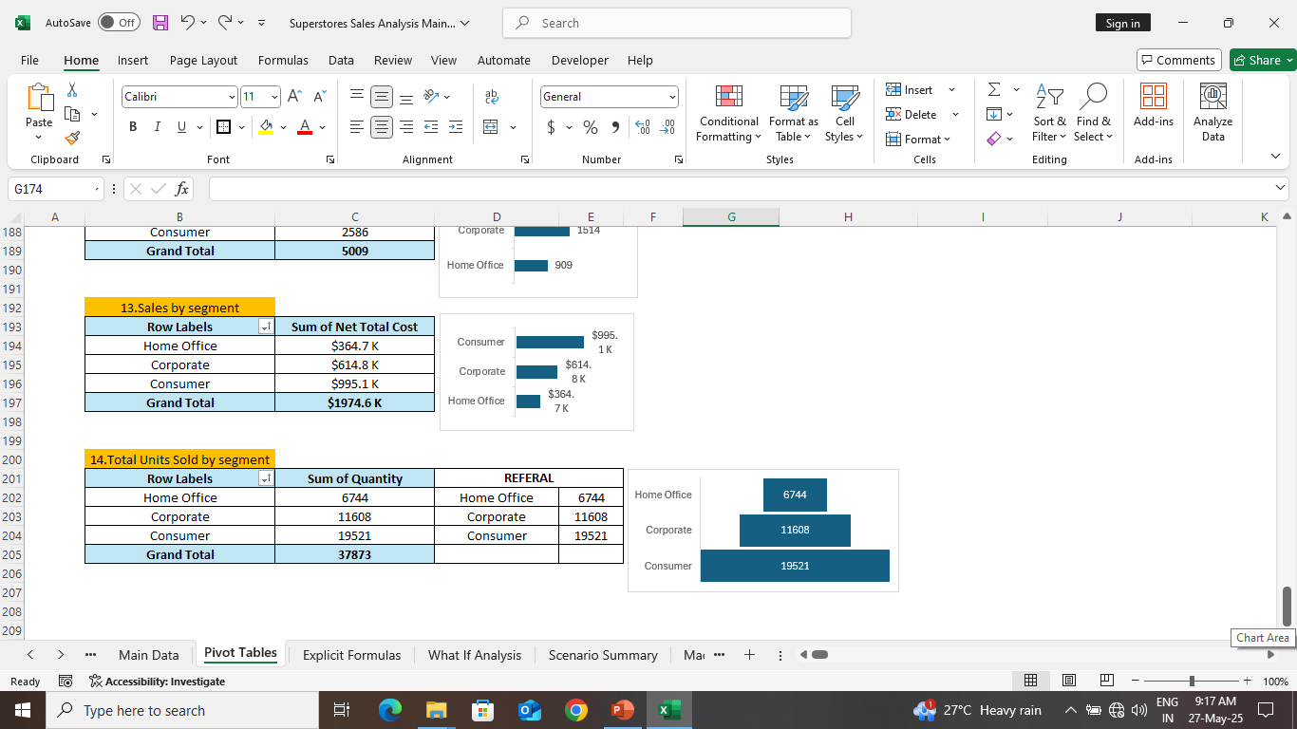
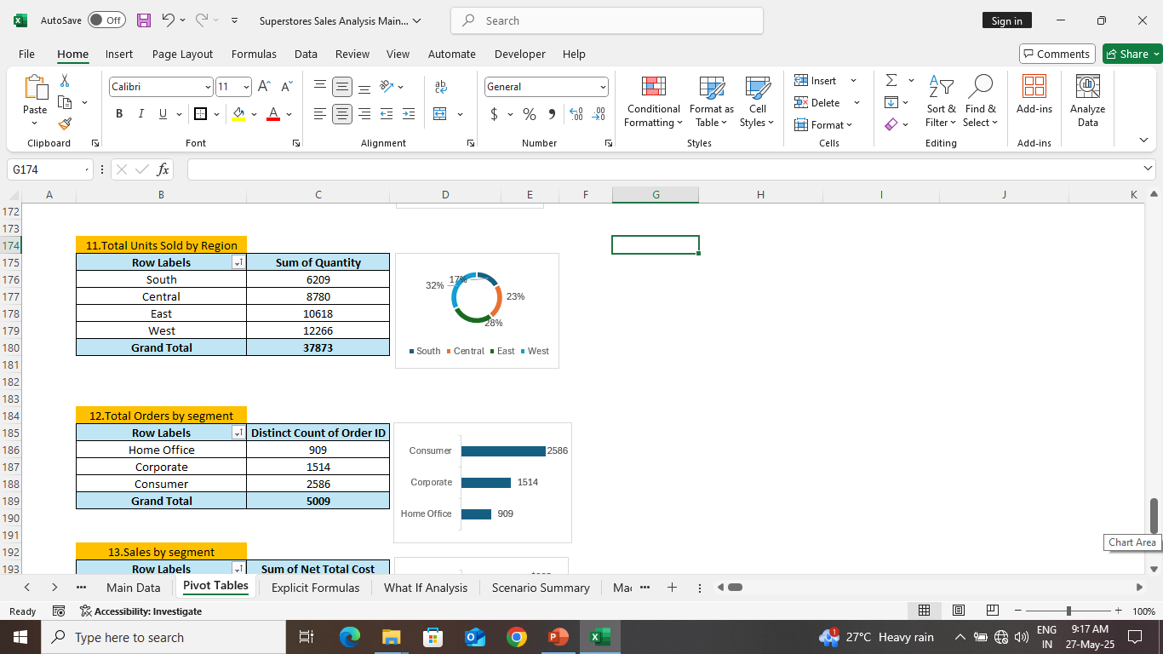
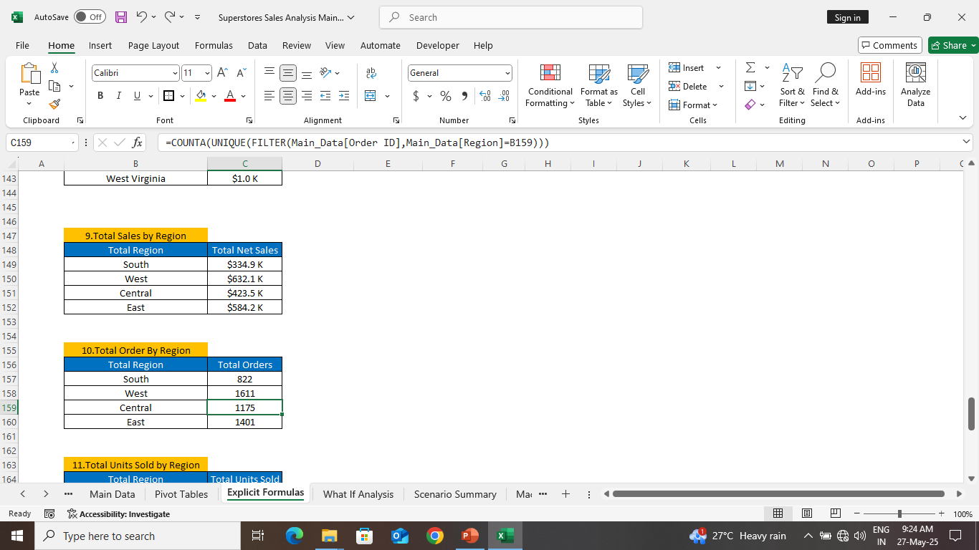
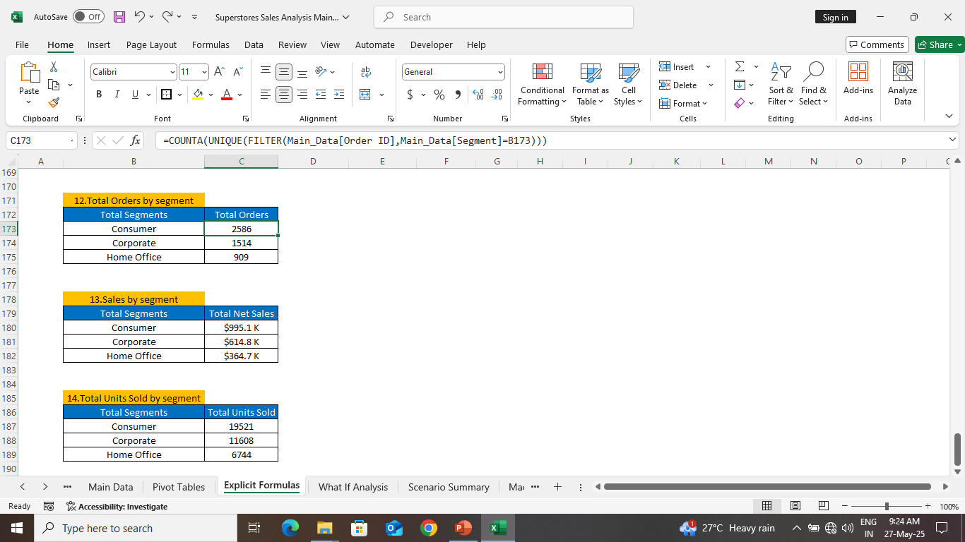
SALES BY CITIES
TOP PERFORMING PRODUCTS
LOW PERFORMING PRODUCTS
SALES BY REGION & SEGMENT

Slide 26
LOW PERFORMING PRODUCTS
SALES BY REGION & SEGMENT
SALES BY REGION & SEGMENT

Slide 27
SALES BY REGION & SEGMENT
SALES BY REGION & SEGMENT

Slide 28

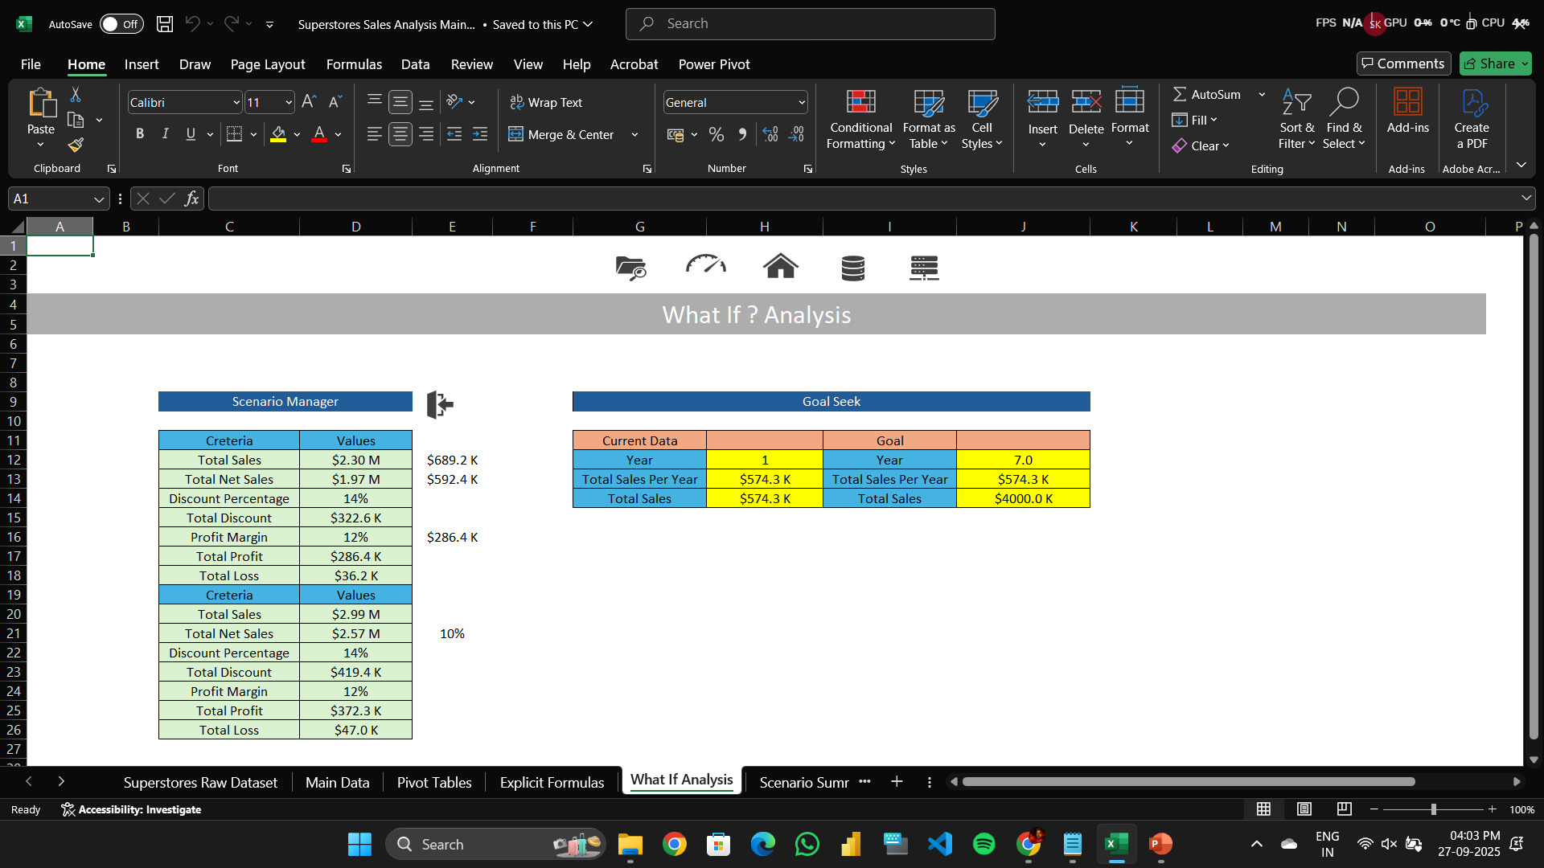
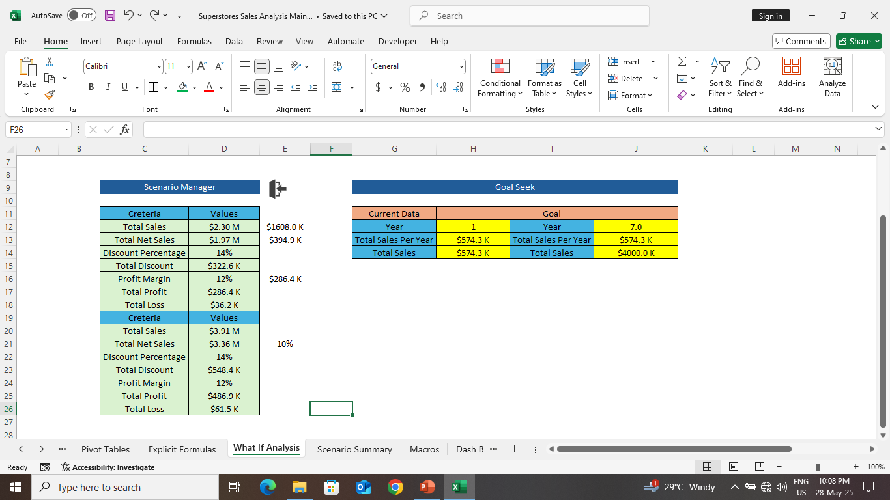
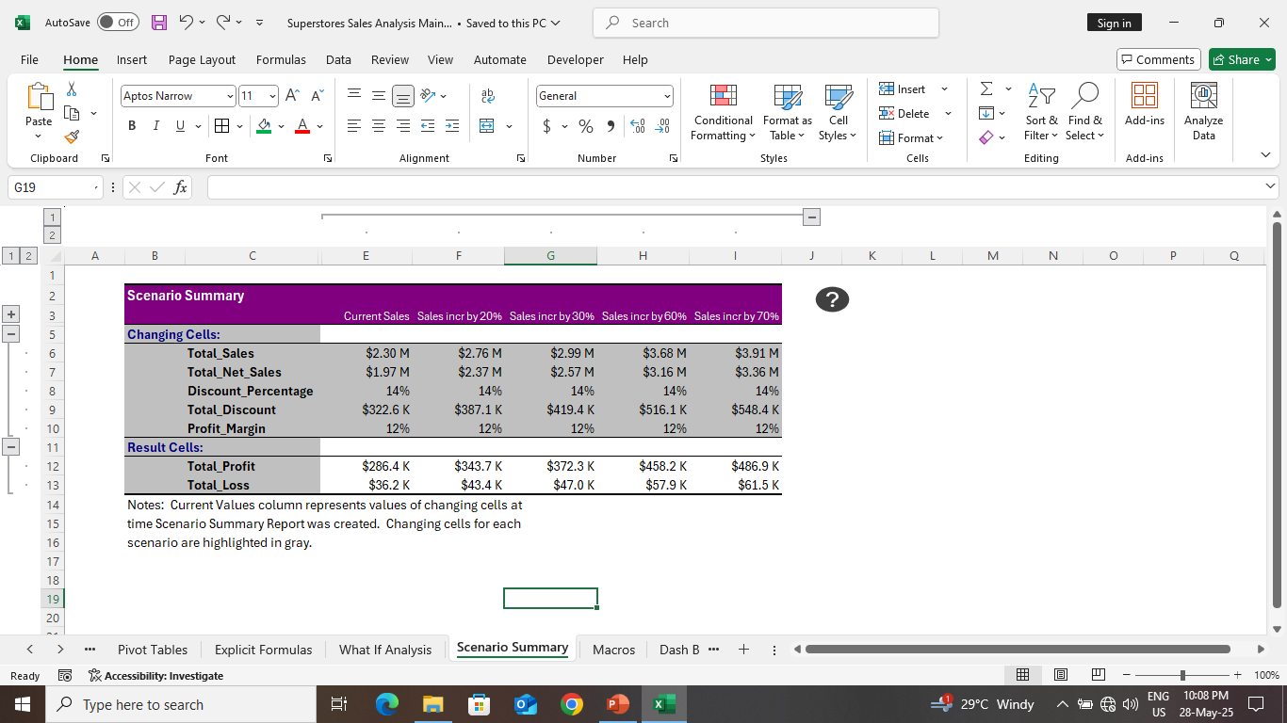
MACROS & WHAT IF ANALYSIS
WHAT IF ANALYSIS
SCENARIO MANAGER
GOAL SEEK

Slide 29
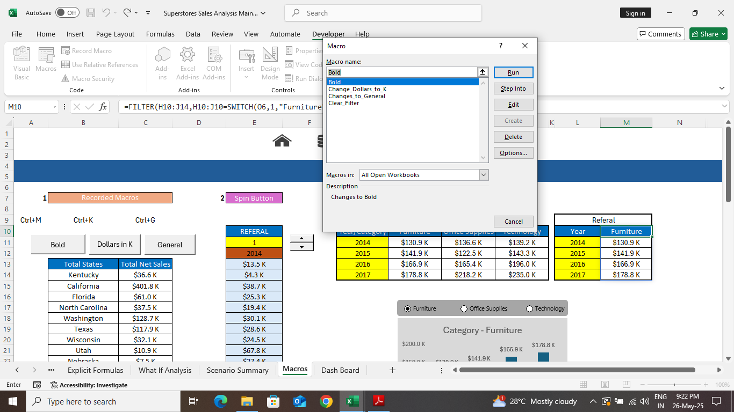
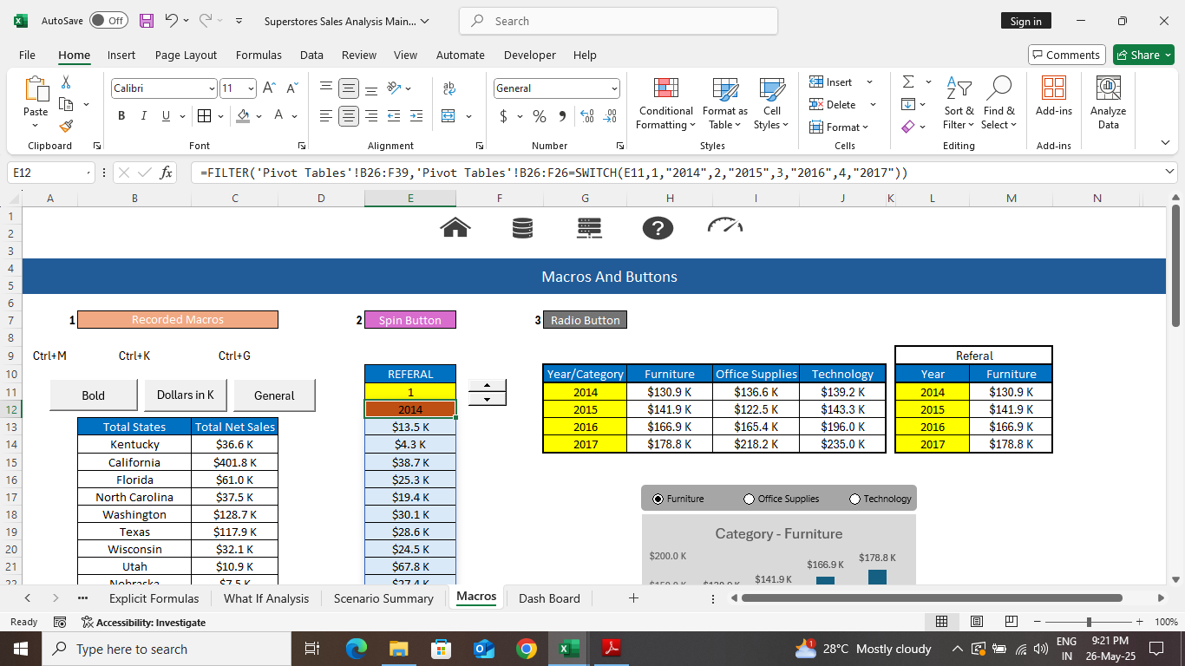
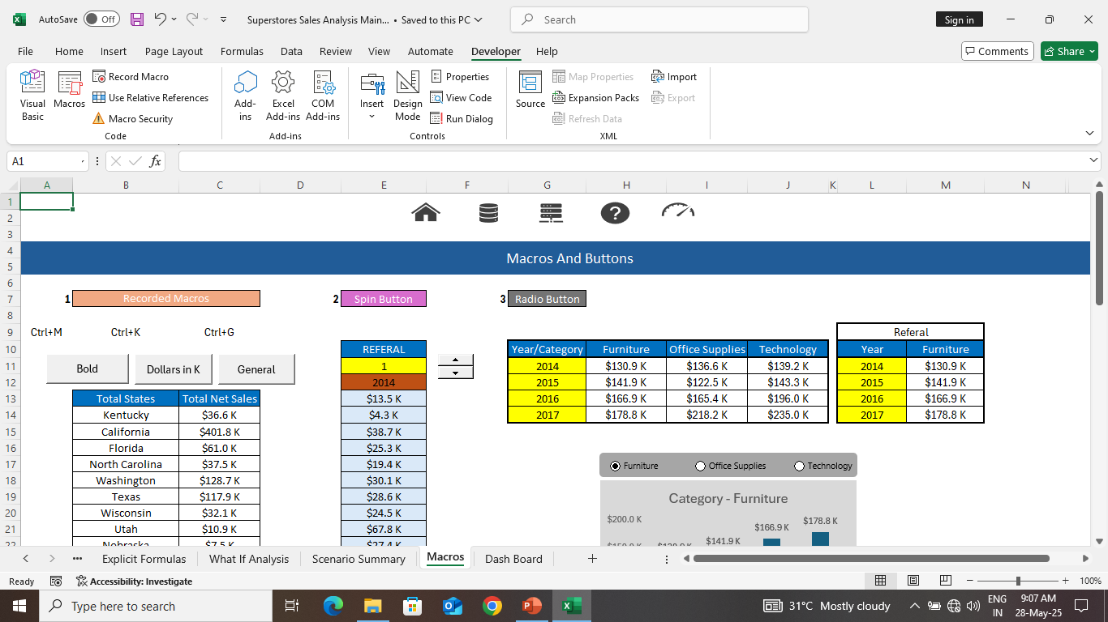
WHAT IF ANALYSIS
MACROS
SCENARIO MANAGER
GOAL SEEK
RECORDED MACRO BUTTON

Slide 30
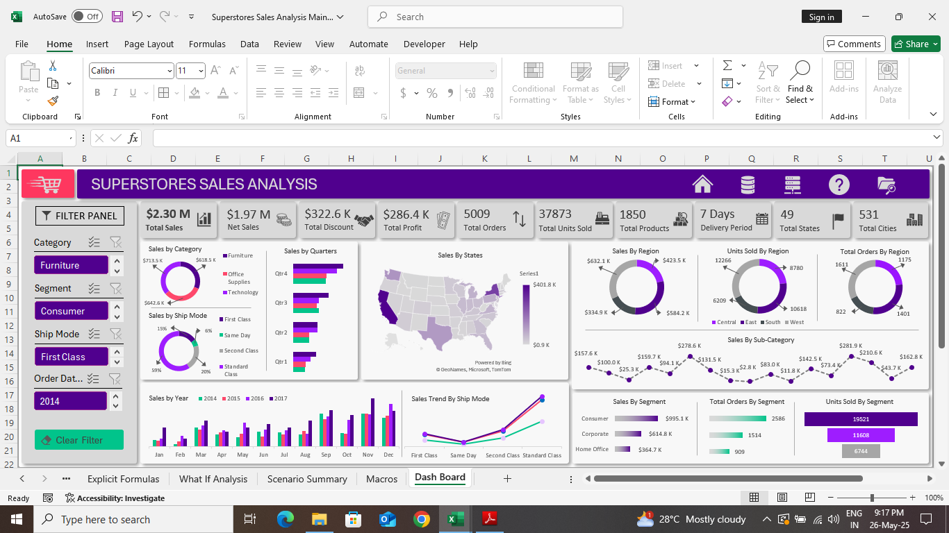

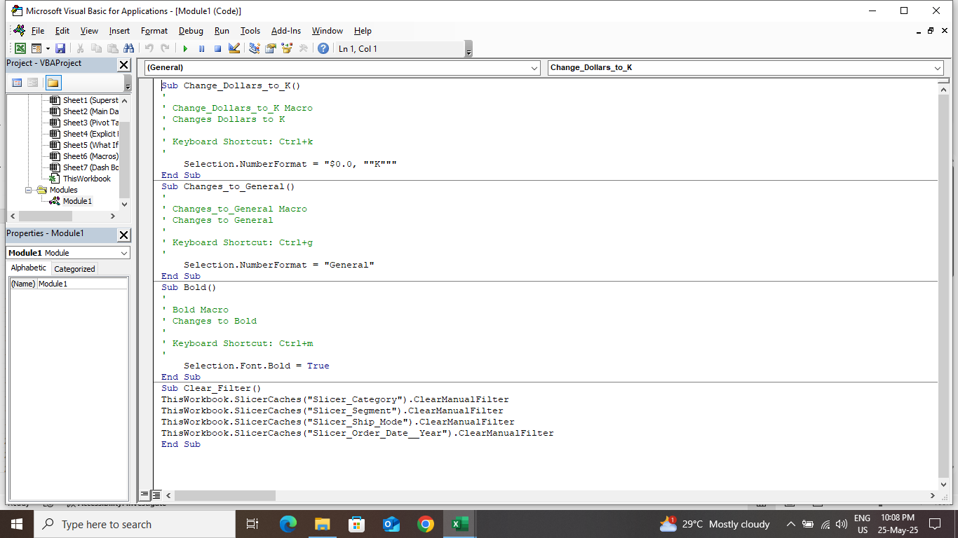
WHAT IF ANALYSIS
MACROS
SCENARIO MANAGER
GOAL SEEK
RECORDED MACRO BUTTON
CELL REFERRED MACRO BUTTON
CELL REFERRED MACRO BUTTON

Slide 31
MACROS
RECORDED MACRO BUTTON
CELL REFERRED MACRO BUTTON

Slide 32
DASHBOARD
DASHBOARD

Slide 33
DASHBOARD

Slide 34
CONCLUSION
CONCLUSION
HIGH PERFORMING SUB-CATEGORY PHONE – $ 281.9 K.
LOWEST PERFORMING SUB-CATEGORY FASTENER – $ 2.8 K,
FURNITURE AND TECHNOLOGY IS PERFORMED BETTER.
HIGHEST PERFORMINF STATE IS CALIFORNIA – $ 401.8 K.
LOWEST PERFORMINF STATE IS NORTH DAKODA – $ 0.9 K.
TOTAL SALES IN SOUTH REGION IS LOW & WEST REGION IS HIGH .
TOTAL SALES IN CATEGORY OF HOME OFFICE IS LOW & CONSUMERS IS HIGH.
PEOPLE USED THE STANDARD CLASS DELIVERY MODE THE MOST.
SALES IS HIGHER IN CENTRAL REGION.
SALES IS HIGHER IN CONSUMER SEGMENT.
WE NEED ADVERTISE THE DEALS AND OFFERS AND ALSO MAKE IT UNPREDICTABLE.

Slide 35
CONCLUSION
HIGH PERFORMING SUB-CATEGORY PHONE – $ 281.9 K.
LOWEST PERFORMING SUB-CATEGORY FASTENER – $ 2.8 K,
FURNITURE AND TECHNOLOGY IS PERFORMED BETTER.
HIGHEST PERFORMINF STATE IS CALIFORNIA – $ 401.8 K.
LOWEST PERFORMINF STATE IS NORTH DAKODA – $ 0.9 K.
TOTAL SALES IN SOUTH REGION IS LOW & WEST REGION IS HIGH .
TOTAL SALES IN CATEGORY OF HOME OFFICE IS LOW & CONSUMERS IS HIGH.
PEOPLE USED THE STANDARD CLASS DELIVERY MODE THE MOST.
SALES IS HIGHER IN CENTRAL REGION.
SALES IS HIGHER IN CONSUMER SEGMENT.
WE NEED ADVERTISE THE DEALS AND OFFERS AND ALSO MAKE IT UNPREDICTABLE.

Slide 36


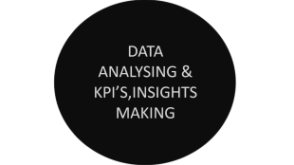



ANALYSIS FLOW
WE ARE GOING SEE HOW TO CLEAN THE DATA AND USING THE CLEANED DATA,
WE ARE GOING TO ANALYZE THE KPI’S AND INSIGHTS USING PIVOT TABLES & PIVOT CHARTS TO HIGH AND LOW PERFORMINGAREAS , TO EASE THE UNDERSTANDING OF THE ANALYSIS WE ARE GOING TO CREATE A INTERACTIVE DASHBOARD WHICH WILL HAVE THE VISUALIZATION OF THE ALL KPI’SAND IMSIGHTS
THANK YOU

